Slide 1
Fancy
Trees

Slide 2
Expression Tree
A binary expression tree is a binary tree
in which each parent node contains an operator and each leaf contains a number.
+
4-5+6*7
-
*
4
5
6
7

Slide 3
Threaded Tree
A threaded binary tree is a binary tree
with an additional reference in each
node that is used to point from a child
back to its parent.

Slide 4
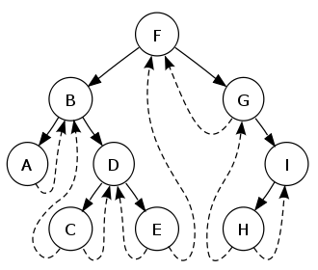
Threaded Tree

Slide 5
Threaded Tree
public class ThreadedTreeNode {
private Comparable treeNodeValue;
private ThreadedTreeNode leftTreeNode;
private ThreadedTreeNode rightTreeNode;
private ThreadedTreeNode parentTreeNode;
//constructors and methods not shown
}

Slide 6
Threaded Tree
null
50
35
70
null
null
null
null

Slide 7
BigO

Slide 8
Big-O Notation
Big-O notation is an assessment of an
algorithm’s efficiency. Big-O notation
helps gauge the amount of work that
is taking place.
Common Big O Notations :
O(1) O(Log₂N)
O(2^{N}) O(N²)
O(N Log₂N) O(N)
O(Log₂N) O(N³)

Slide 9
Binary Search Tree
Average case = these results assume the tree is balanced or near balanced.
traverse all nodes O(N)
search for an item O(log₂N)
remove any item O(log₂N) location unknown
get any item O(log₂N) location unknown
add item at the end O(log₂N)
add item at the front O(1)
Notes:
A balanced binary tree is commonly defined as a binary tree in which the depth of the two subtrees of every node never differ by more than 1,^{[3]} although in general it is a binary tree where no leaf is much farther away from the root than any other leaf. (Different balancing schemes allow different definitions of "much farther"^{[4]}). Binary trees that are balanced according to this definition have a predictable depth (how many nodes are traversed from the root to a leaf, root counting as node 0 and subsequent as 1, 2, ..., depth). This depth is equal to the integer part of where is the number of nodes on the balanced tree. Example 1: balanced tree with 1 node, (depth = 0). Example 2: balanced tree with 3 nodes, (depth=1). Example 3: balanced tree with 5 nodes, (depth of tree is 2 nodes).

Slide 10
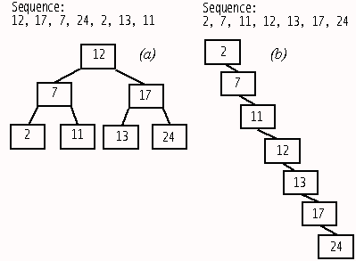
Average case: Balanced Tree (more or less)
Worst case: Data entered in natural order

Slide 11

Start work
on Lab 17
Binary tree visualizer

